Slide 2
Engaging youth as long-acting HIV prevention product co-researchers in the iPrevent study in Cape Town, South Africa
Miriam Hartmann, MPH
@miriamaviva
Share your thoughts on this presentation with #IAS2019

Slide 3
Adherence to prevention has been an issue
South Africa has the largest HIV epidemic in the world, putting its youth at high risk of infection.
Product features
Behavioral issues
Rumors / stigma
Concerns from others
Accessibility

Slide 4
Engaging end-users in the research process before products reach the market is critical
Drug discovery
Preclinical
Clinical
Approval
Consumers

Slide 5
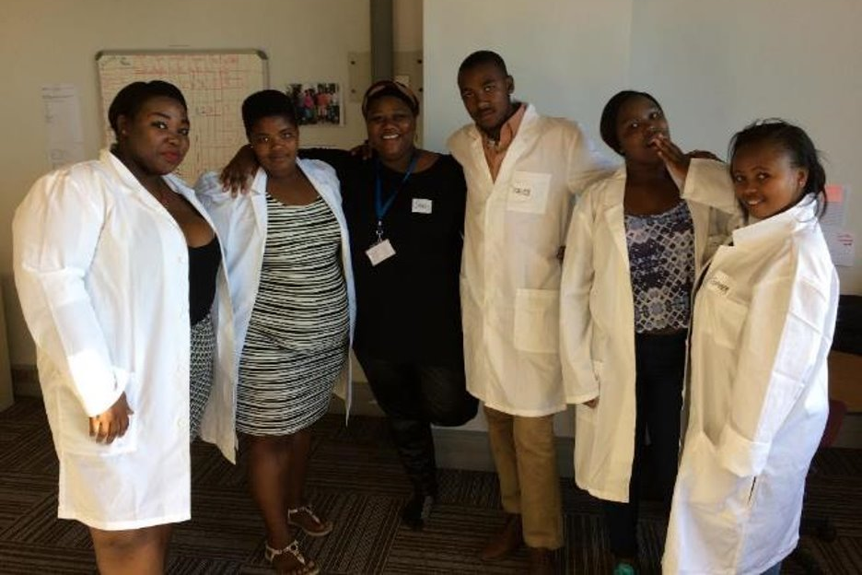
The iPrevent study: “End-user Research to Optimize Adherence to Long-Acting HIV Prevention Approaches”​
A study conducted among end-users ages 18-24 in Cape Town, South Africa to determine the key attributes of a long-acting HIV prevention product that may improve their uptake and adherence.
Aim 1: Qualitative IDIs and FGDs, N=95
Aim 2: Quantitative survey (discrete choice experiment), n=809

Slide 6
Who were the youth we engaged?
Members of the youth community advisory board (CAB) (for ongoing engagement)
Members apply based on a call to community organizations for interested applicants
Made up of heterosexual men, women, and MSM
Convened by DTHF
Bridge the gap between youth in the community and research affecting them
2) Youth recruited by the research team (for select input)

Slide 7
Grounded in best practices for youth engagement, we involved youth as….
product designers
film-makers
survey designers
analysts and interpreters

Slide 8
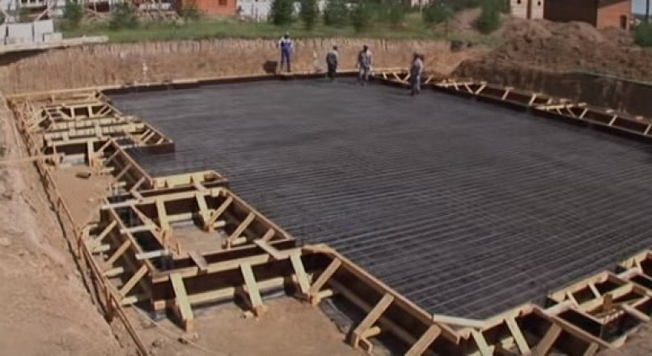
Youth as product co-designers
This was foundational to our approach
Woven into discussion with our youth CAB
Built into language in our recruitment materials and qualitative and quantitative data collection tools
Served as an underlying principle that guided our response to what we learned from youth along the way (e.g. offering training on the research process and product development timeline and process)
“We will share what we learn with scientists who are designing new products.”
“You will help researchers design a product that you, and other youth like you, would actually want to use”

Slide 9
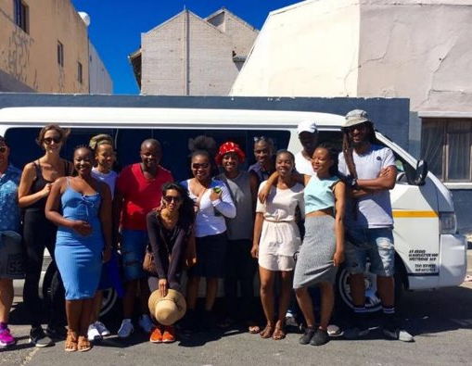
Youth as film-makers
Video Goal
To introduce PrEP to youth participating in the DCE survey
Process:
Pre-production meeting to discuss what’s engaging to youth, previous campaigns of note, and identification of actors
Post-production meeting

Slide 10
Youth as survey designers
20 participants across 3 rounds (9 females, 3 MSM, 7 heterosexual males)
Reviewed
Educational video on PrEP
Introduction to product attributes
Product attribute descriptions and images
Choice set instructions and practice
Each round followed by a ‘cog hash’ where results were reviewed and incorporated for the next round
‘Attributes’ = features of a product that could influence choice

Slide 11
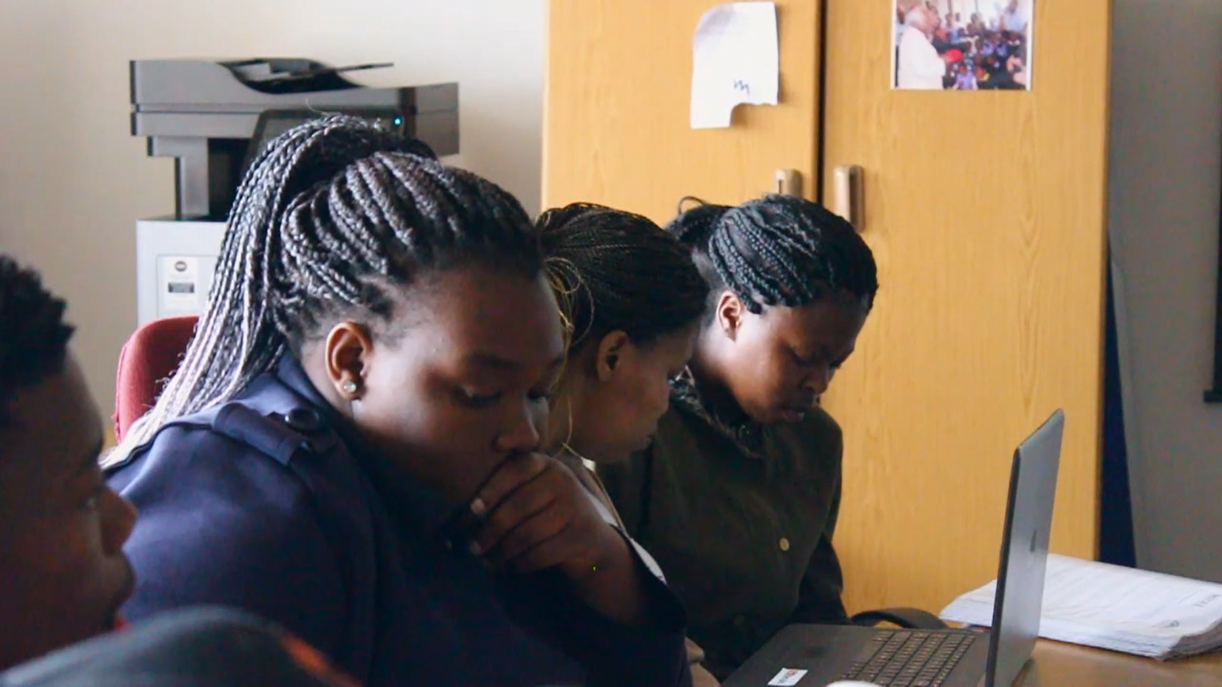
Youth as analysts and reporters
Youth CAB members met to review and interpret qualitative and quantitative results
Responses filmed and edited by a local youth

Slide 12
Impact of youth engagement

Slide 13
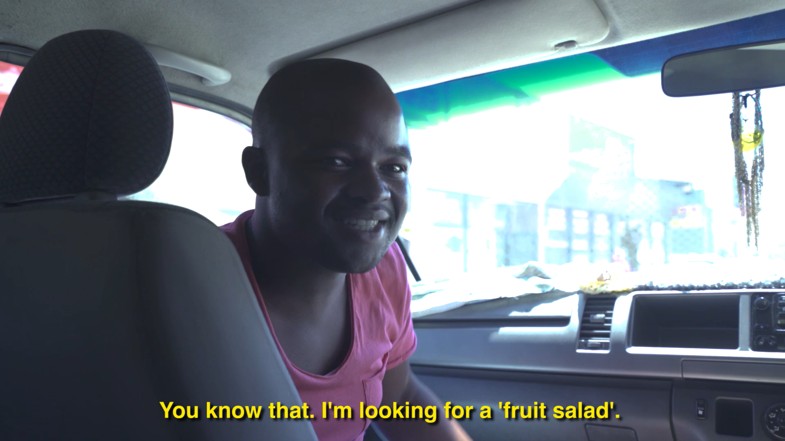
Post-production:
“You nailed it”
Accessible language led to discussion over whatsapp (e.g. ‘fruit salad’)
Add call to action
Make it viral!
Pre-production:
Informed local setting and actors
Suggested key messages – “lend your voice”
Promote male responsibility

Slide 14
Survey design

Slide 15
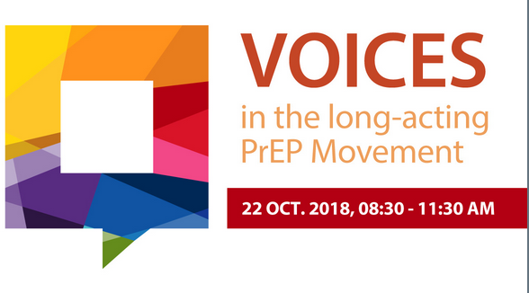
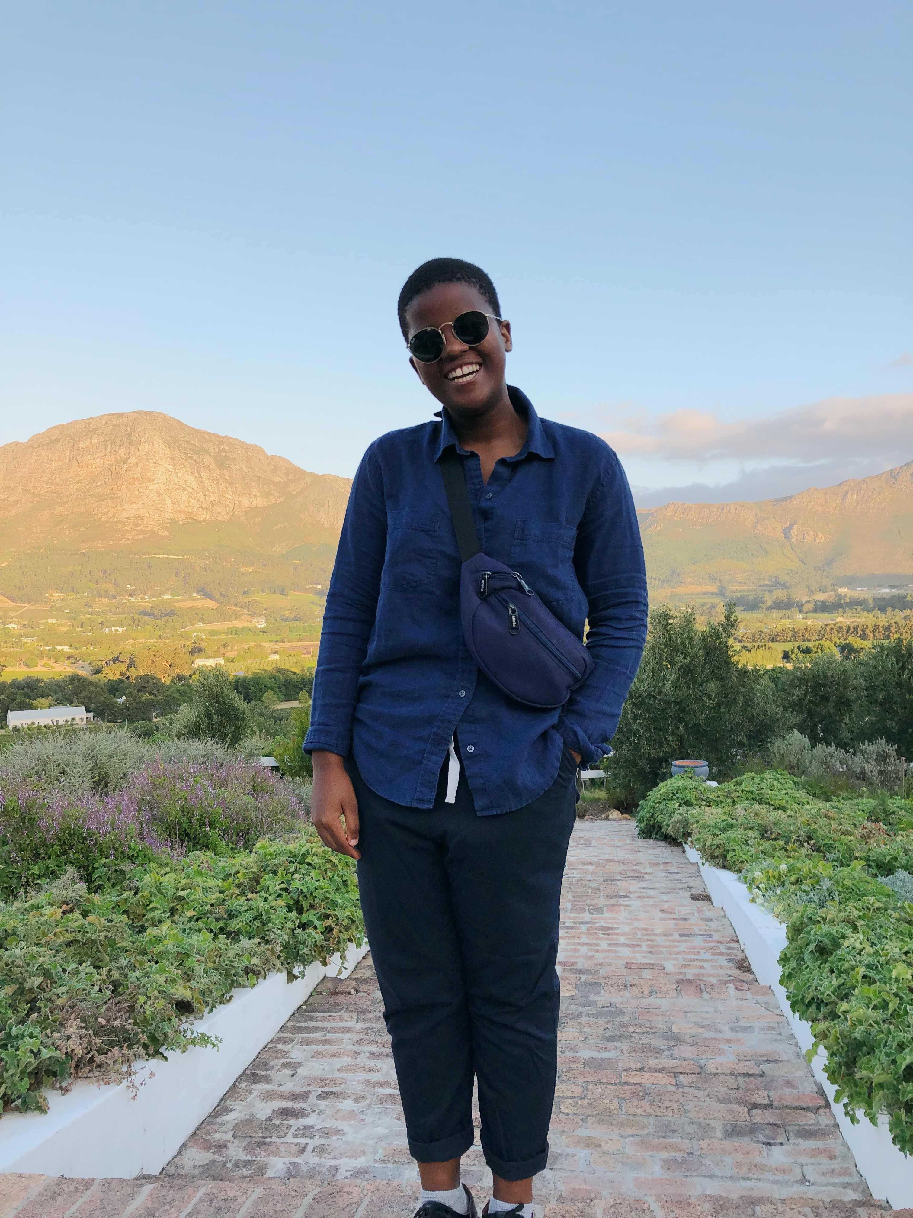
“Don’t disrupt my life” (i.e. consider products that are discrete)
“Youth don’t go well with clinics” (i.e. consider products that can be accessed elsewhere)

Slide 16
Conclusion
Using creative methods – videos and visuals – was successful in engaging youth in the research process
Youth contributed to refining how these issues were described to other youth in videos and visual surveys improving the understandability and relevance of our tools
Taking an iterative approach facilitated the study team’s ability to integrate youth perspectives into the research process and respond to youth capacity needs for research engagement
Check out the iPrevent poster in Sala B for some study results: Montgomery et al. (2019) Young MSM and heterosexual men’s acceptability of long-acting implants and injections for HIV prevention in South Africa: ​ results of a discrete-choice experiment. IAS, Mexico City, 23 July.

Slide 17
Acknowledgements
RTI International​
Erica Browne ​
Rachel Weinrib​
Miriam Hartmann​
Emily Krogstad​
Ariane van der Straten​
Carol Mansfield​
Marco Boeri​
Shannon O’Rourke​
And our study participants!​
DTHF​
Sheily Ndwayana ​
Siyaxolisa Sindelo ​
Nangamso Ngcwayi​
Thando Wonxie​
Buhlebenkosi Msipha​
Nomakaziwe Siko​
Anelisiwe Ngcuka​
Yamkelani Simakuhle ​
Flora Thobela​
Nontembeko Qwabe​
Amanda Norexe​
Daniel Ndzuzo​
Linda-Gail Bekker​

